Slide 1
Patient Safety Advocacy: Safer Together
Deborah E. Prowse, Q.C.
Patients for Patients Safety Canada
Alberta Health Advocate

Slide 2
Patient Safety Matters
2004 in Calgary, 2 patients died unnecessarily from a single adverse event
A key contributor was a culture that did not support patient safety
- Communication
- Lack of priority
- Complacency about safety

Slide 3
What was the Patient Safety awareness?
To Err is Human was a report released in the U.S. in 1995
Recognized that both individual dedication and collective contributions of those who give their all to improve and save lives of patient in our healthcare institutions
Baker Norton study was released in Canada in 2004
Revealed thousands of patients are brought to harm in the course of their healing because of fundamental problems n the individual and collective behavior of caring professionals
Shift from culture of blame to culture of patient safety

Slide 4
Let’s talk
Contributors to adverse events are known and even talked about but not reported.
Someone who cuts corners
Someone who makes mistakes
Hazards
Someone who is a bully
Someone who is incompetent
This contributes to
Avoidable errors
Moral and ethical distress
Burnout and decreased morale
Reduced productivity

Slide 5
Patient Safety in your world
Communication is critical to patient safety.
It is a top contributor to sentinel events. Some studies show more than 60% of medical errors are caused by mistakes in interpersonal communication.
We know it factors into processes of clinical care relative to preassessments, informed consents and operating room teamwork.
Significant initiatives have been introduced to address workforce issues, hours of work, care bundles, checklists, simulation and teamwork training, etc.

Slide 6
Why is this important to me?

Slide 9
So, what did we learn?
Patients/families were both scared of each other.
Patients suffer two kinds of harm – the first related to the event itself and the second related to how they are treated after the event.
Patients/families and providers go through similar reactions after a harm event.
Neither patients/families or providers can make your system safer alone – we need each other.
Patient safety culture needs: just culture, reporting system, disclosure after harm and a focus on learning.

Slide 11
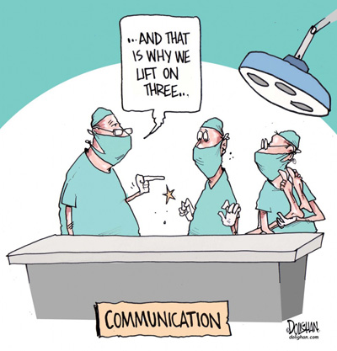
What are the 3 critical conversations you can have?

Slide 12
About hazards and risks so that we can build defenses

Slide 13
Engaging patients as partners in their care to avoid failure to rescue, etc.

Slide 14
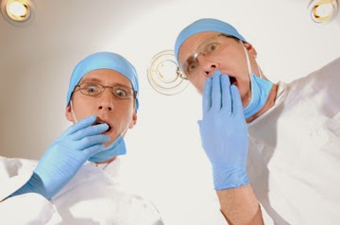
With each other to make patient safety a priority and to provide support when the inevitable happens.
“Resilience may not lie within the
individuals, but between the
individuals.” Dr. Matt Walton
Patient safety and Staff safety are related. We are safer together.
Notes:
“We have chosen a calling that invites people who are worried and suffering to share their stories and allow us to help. If any work ought to give spiritual satisfaction to the workers, this is it. ‘Joy’ not ‘burnout’ out to rule the day.” Dr. Don Berwick

Slide 15
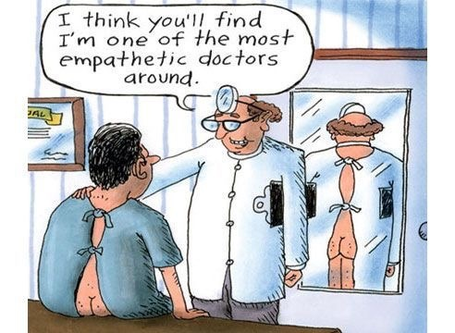
Thank you!
Deborah E. Prowse, Q.C.
deborah.prowse@gmail.com
Telephone: (403) 650-5561

